Slide 1
Meeting 17.10.2016

Slide 2
Expect grade
Jiaqi Ni | 8.5
Kalina Petrova | 8.5
Wen Zhang | 8.5
Jianfei Feng | 7.0
Mengchuan Liu | 8.0
Jiefan Lin | 8.0

Slide 3
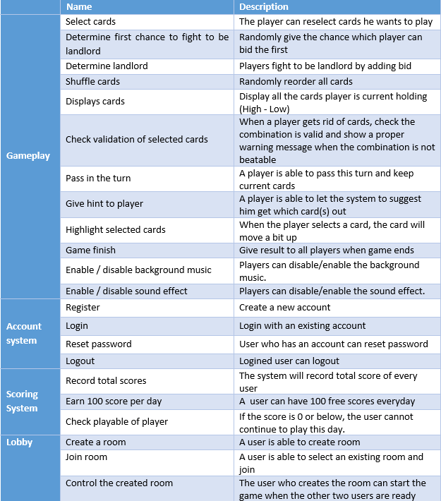
Use cases

Slide 4
MOSCOW
Must
Join room
Select cards
Determine first chance to fight to be landlord
Determine landlord
Shuffle cards
Display cards
Check validation of selected cards
Pass in the turn
Give hints to player
Highlight selected cards
Record total scores

Slide 5
MOSCOW
Should
Register
Login
Logout
Check playable of player

Slide 6
MOSCOW
Could
Reset password
Create a room
Control the create room
Enable / disable background music
Enable / disable sound effect

Slide 7
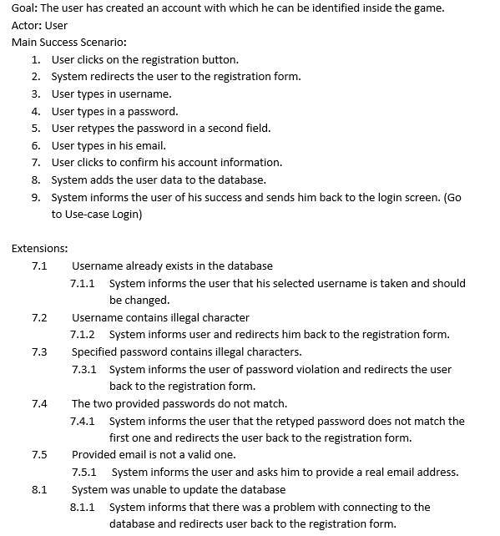
Register

Slide 8
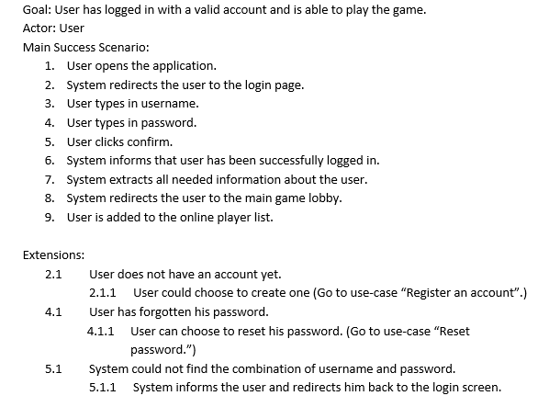
Login

Slide 9
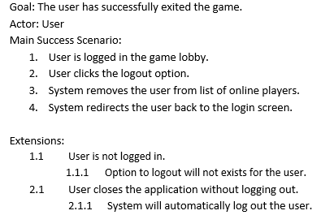
Logout

Slide 10
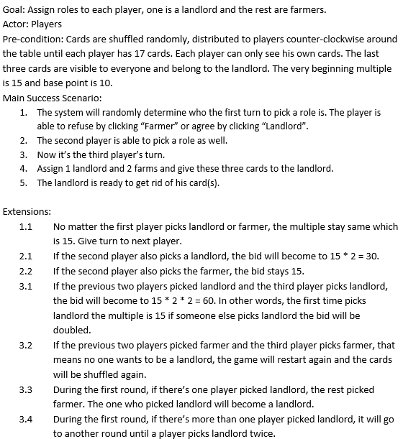
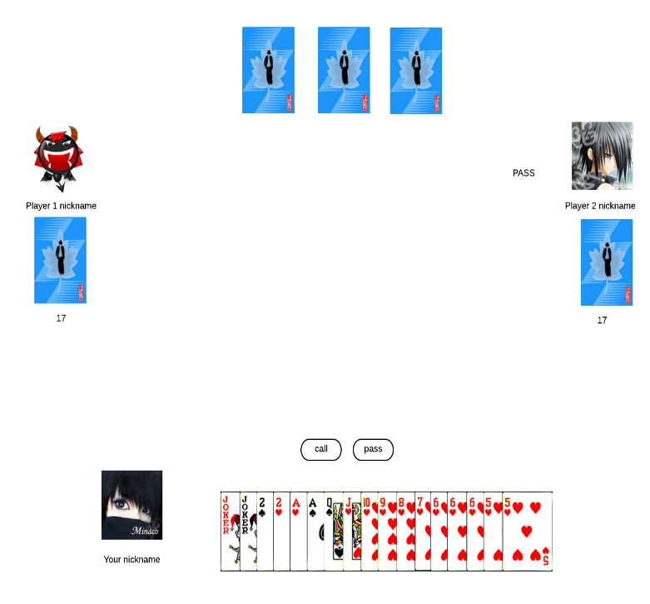
Determine the landlord

Slide 11
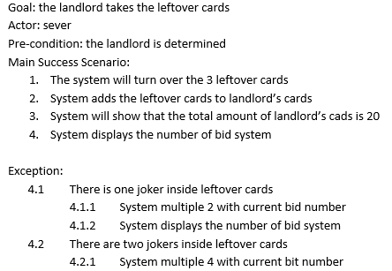
Give leftover cards to landlord

Slide 12
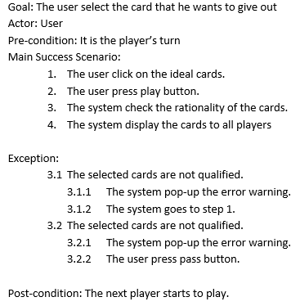
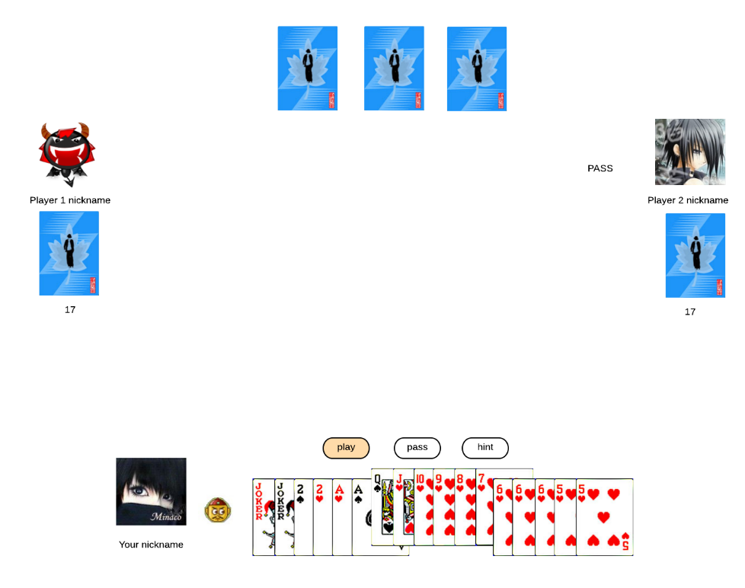
Select cards

Slide 13
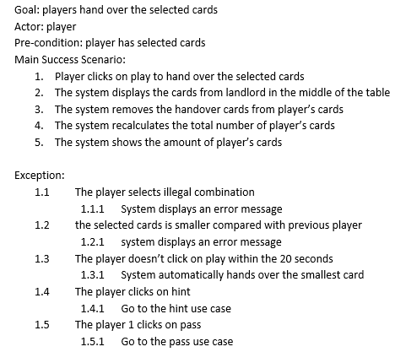
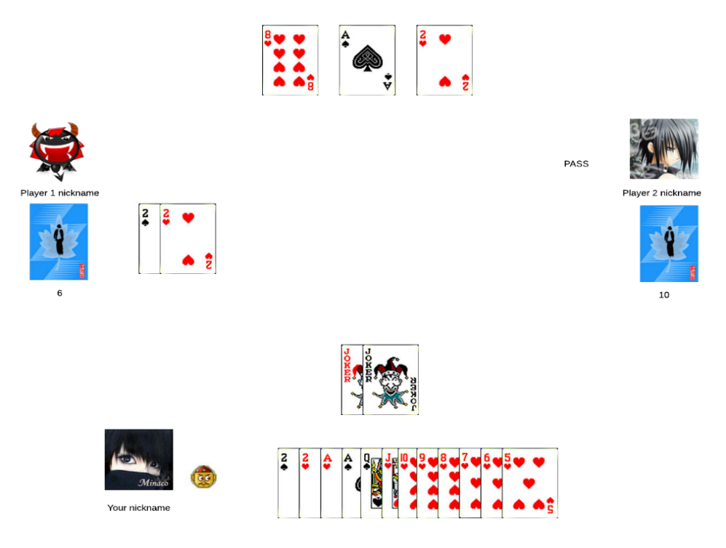
Hand over cards

Slide 14
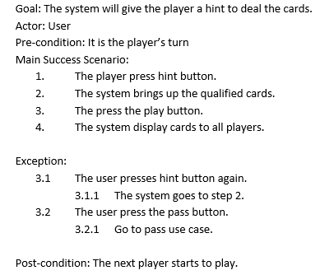
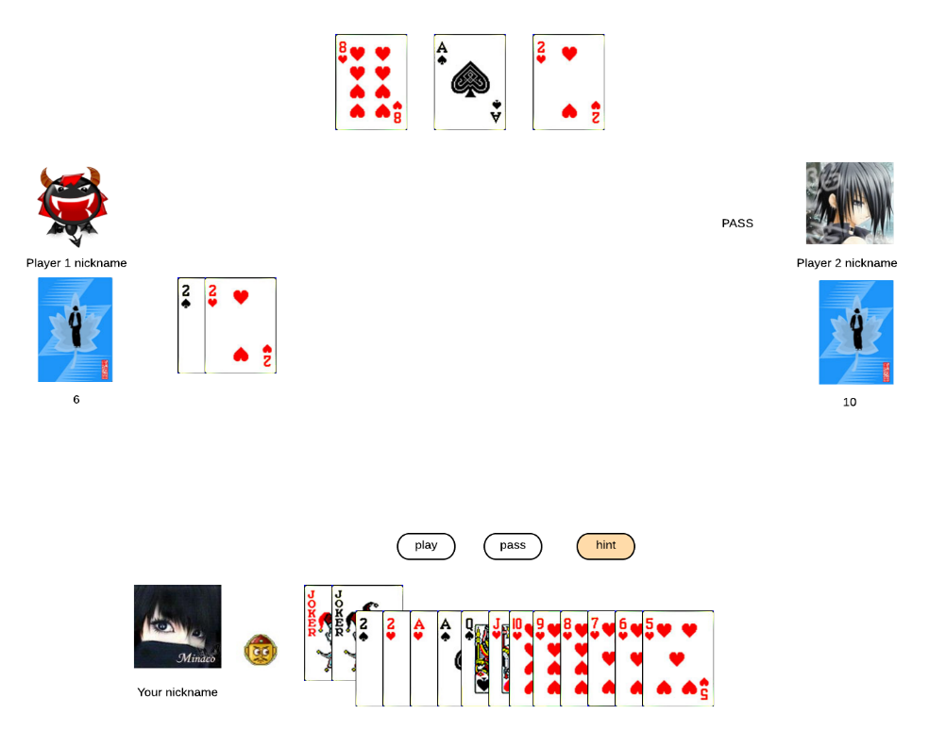
Give hints to player

Slide 15
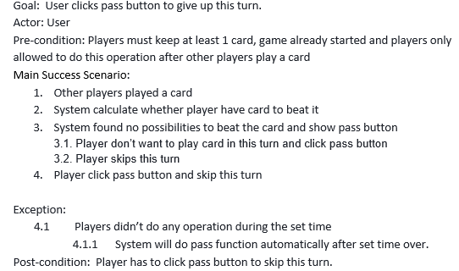
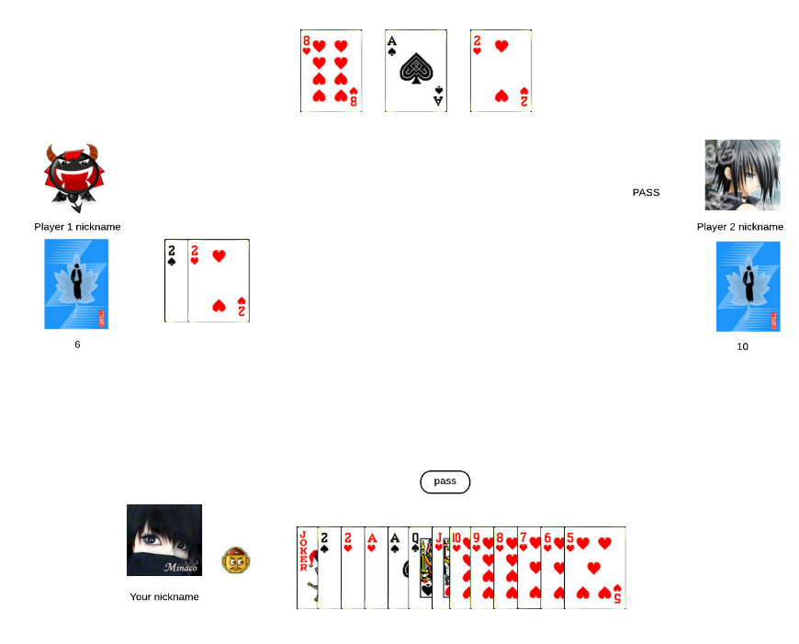
Pass in the turn

Slide 16
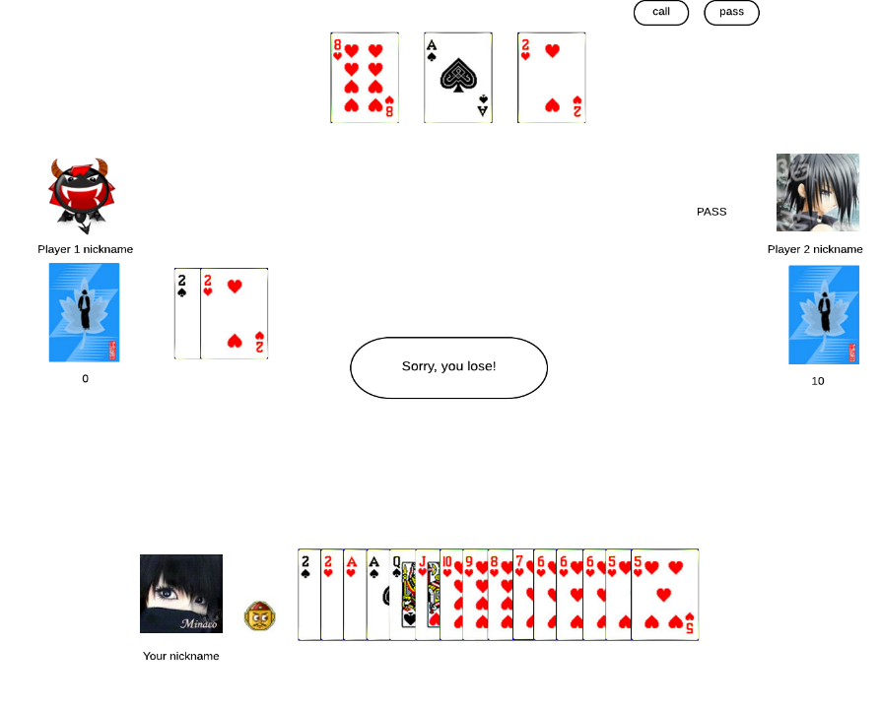
Game finish
Goal: User finished match and system show prompt message win or lose
Actor: User
Pre-condition: At least there is one player get rid of all the cards
Main Success Scenario:
Player get rid of the last card
System show “congratulation, you win！” or “Sorry, you lose”

Slide 17
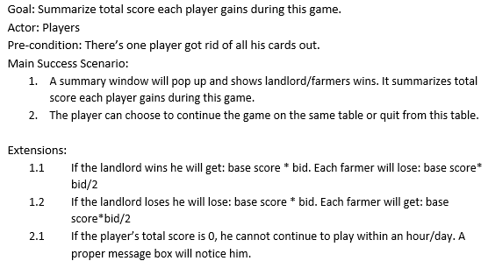
Record total scores

Slide 18
Non-functional requirements
Usability – The application will not be intrusive and will have an easy to understand GUI. The application’s interaction will be intuitive.
Usability will be tested using actual user interaction. We will present a group of people that represent our user base with the demo products and monitor how they navigate through the application. Using these observations we will determine which parts are alright as they are and which need modification. We will conduct these user tests during our testing period of each iteration.
Since we are creating a logical card game application, it would be beneficial to present the rules of the game and the different functionalities to the user using a small tutorial to get them used to the application.

Slide 19
Non-functional requirements
Performance – This is an important aspect in any Simulation. The application will not take up unnecessary computer memory or computing time. It will match with efficiency standards allowing the simulations to run smoothly.
We will try to test the application on various machines and devices to ensure that the performance is not constrained by any specific requirement. (CPU, GPU, RAM)

Slide 20
Non-functional requirements
Reliability – All the simulations from the software will be accurate and precise. They will provide with an ideal situation of traffic control that is not influenced by forces not stated by the client. Any outside tempering with the system will be prevented and prohibited.
During our user testing we will also make sure that the users get the desired results and that there are no exceptions to the rules.
We will also try to cover the code with unit testing as much as possible to make sure no bugs occur due to unexpected input.

Slide 21
Non-functional requirements
Maintainability – The software will be provided with error protection protocols. The software will be written in proper standards, making it easy to be accessed from third parties.

Slide 22
Non-functional requirements
Extensibility – We will make sure that the code is as clean as possible and structured in a nice way so that there won’t be any difficulty when adding additional features.
To ensure that our architecture and code are extensible and maintainable, we will try to research on all the possible functionalities that could be implemented into our application and take those into consideration when designing the system.

